Slide 1

Introduction to Spring Framework

Slide 2

Content
What is Spring Framework?
Key features of Spring Framework
Dependency Injection and Inversion of Control
Aspect Oriented Programming
Spring Modules
Advantages of using Spring Framework

Slide 3
What is Spring Framework?
Spring is the most popular application development framework for enterprise Java.
Open source Java platform since 2003.
Spring supports all major application servers and JEE standards.
Spring handles the infrastructure so you can focus on your application.

Slide 4
Dependency Injection Introduction to Concept
The technology that actually defines Spring (Heart of Spring).
Dependency Injection helps us to keep our classes as indepedent as possible.
Increase reuse by applying low coupling
Easy testing
More understandable

Slide 5
Dependency Injection Introduction to Concept
An injection is the passing of a dependency (a service) to a dependent object (a client). Passing the service to the client, rather than allowing a client to build or find the service, is the fundamental requirement of the pattern.
“Dependency injection is a pattern where the container passes objects by name to other objects, via either constructors, properties, or factory methods.”

Slide 6
Dependency Injection Relationship Between DI and Inversion of Control
In software engineering, inversion of control (IoC) describes a design in which custom-written portions of a computer program receive the flow of control from a generic, reusable library.
The Inversion of Control (IoC) is a general concept, and it can be expressed in many different ways and dependency Injection is merely one concrete example of Inversion of Control.

Slide 7
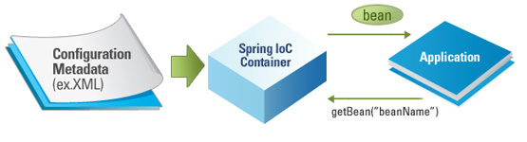
Dependency Injection IoC Container
The Spring container (IoC Container) is at the core of the Spring Framework.
The container will create the objects, wire them together, configure them, and manage their complete lifecycle from creation till destruction.

Slide 8
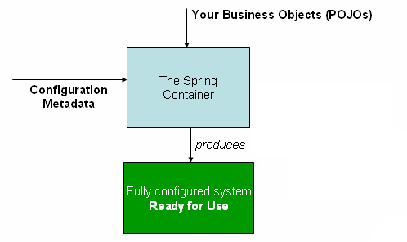
Dependency Injection IoC Container
The container gets its instructions on what objects to instantiate, configure, and assemble by reading configuration metadata provided.
The configuration metadata can be represented either by;
XML,
Java annotations,
Java code.

Slide 9
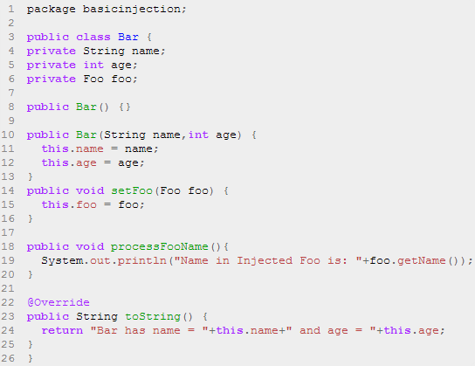
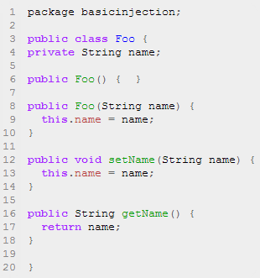
Dependency Injection Code Example
To instantiate the above classes, one way is to do the usual new operator like new Foo() or new Bar() OR we can use the Spring dependency injection to instantiate these classes and set the properties accordingly.

Slide 10
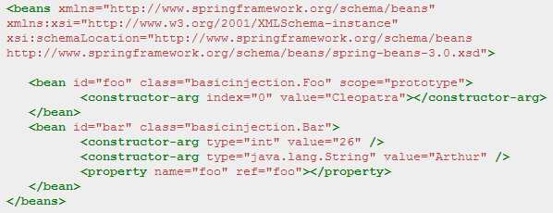
Dependency Injection Code Example
Foo f = new Foo("Cleopatra");
Bar b = new Bar("Arthur",26); b.setFoo(f);

Slide 11
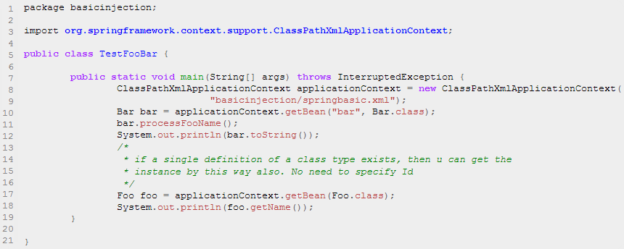
Dependency Injection Code Example
Spring's ClassPathXmlApplicationContext is the commonly used object that hold the information of all the beans that it instantiates.

Slide 12
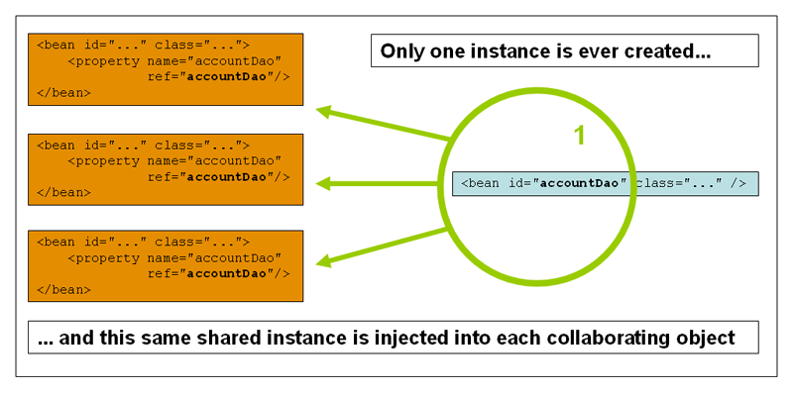
Dependency Injection Bean Scopes
Scope | Description
Singleton | (Default) Scopes a single bean definition to a single object instance per Spring IoC container.
Prototype | Scopes a single bean definition to any number of object instances.

Slide 13
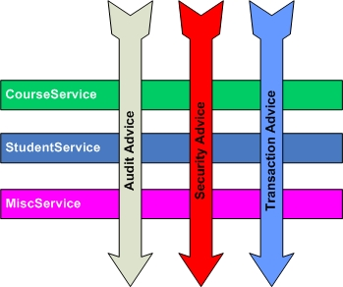
Aspect Oriented Programming (AOP) Introduction to Concept
AOP entails breaking down program logic into distinct parts called concerns.
The functions that span multiple points of an application are called cross-cutting concerns and these cross-cutting concerns are conceptually separate from the application's business logic.
AOP is like triggers in programming languages
such as Perl, .NET, Java and others.
Examples of cross-cutting concerns:
Logging
Security
Transaction
Caching

Slide 14
Aspect Oriented Programming (AOP) Spring AOP
Spring AOP module provides interceptors to intercept an application, for example, when a method is executed, you can add extra functionality before or after the method execution.
Spring AOP's approach to AOP differs from that of most other AOP frameworks. The aim is to provide a close integration between AOP implementation and Spring IoC, not to provide the most complete AOP implementation.
Spring Framework's AOP functionality is normally used in conjunction with the Spring IoC container. Aspects are configured using normal bean definition syntax.

Slide 15
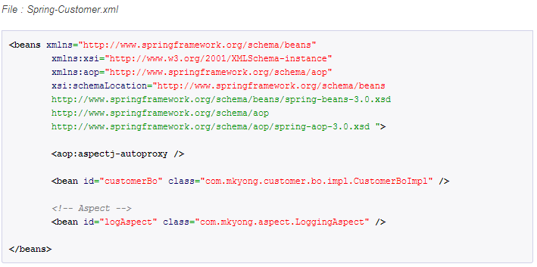
Aspect Oriented Programming (AOP) Code Example

Slide 16
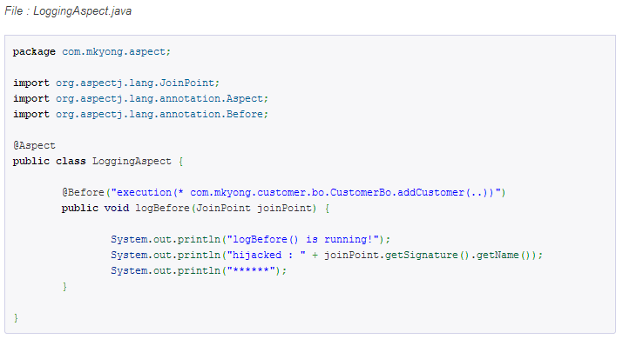
Aspect Oriented Programming (AOP) Code Example
@Before – Run before the method execution
@After – Run after the method returned a result
@AfterReturning – Run after the method returned a result, intercept the returned result as well.
@Around – Run around the method execution, combine all three advices above.
@AfterThrowing – Run after the method throws an exception
Pointcut (AspectJ Pointcut Expression Language)
Join Point
Advice

Slide 17
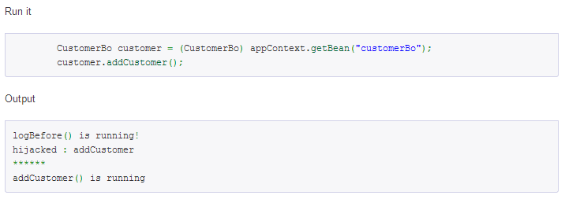
Aspect Oriented Programming (AOP) Code Example

Slide 18
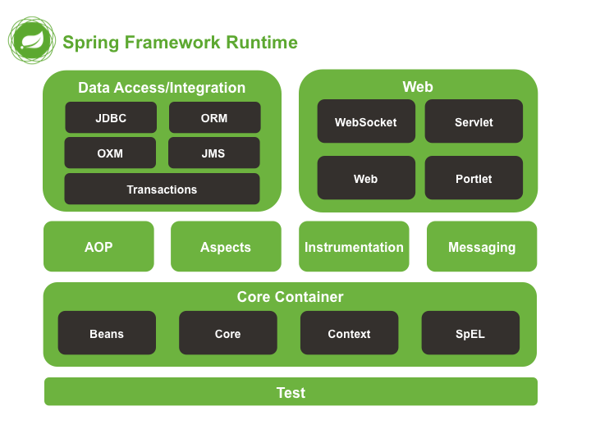
Spring Modules
The Spring Framework consists of features organized into about 20 modules.
These modules are grouped into Core Container, Data Access/Integration, Web, AOP (Aspect Oriented Programming), Instrumentation, and Test.
Overview of the Spring Framework

Slide 19
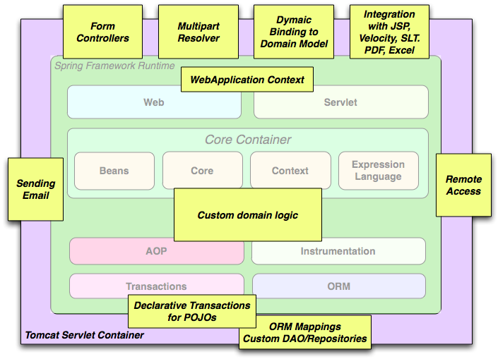
Spring Modules
The building blocks described previously make Spring a logical choice in many scenarios, from applets to full-fledged enterprise applications that use Spring's transaction management functionality and web framework integration.
Typical full-fledged Spring web application

Slide 20
Spring Modules Spring Projects
Spring XD
Spring Data
Spring Integration
Spring Batch
Spring Security
Spring Cloud
Spring AMQP
Spring Grails
Spring Mobile
Spring Social
Spring for Android
Spring Web Flow
Spring LDAP
Spring Groovy
Spring Hateoas
Spring Security OAuth

Slide 21

Advantages of Using Spring Framework
Open source
Lightweight and fast
Moduler structure
Low coupling thanks to Dependency Injection
Resuable software
AOP support
Stable and lots of resources
Projects that make our life easier like Spring Security

Slide 22
Introduction to Spring Framework - Part 2

Slide 23
Content
Spring MVC
Spring RESTful Services
Spring Security
Spring Test

Slide 24
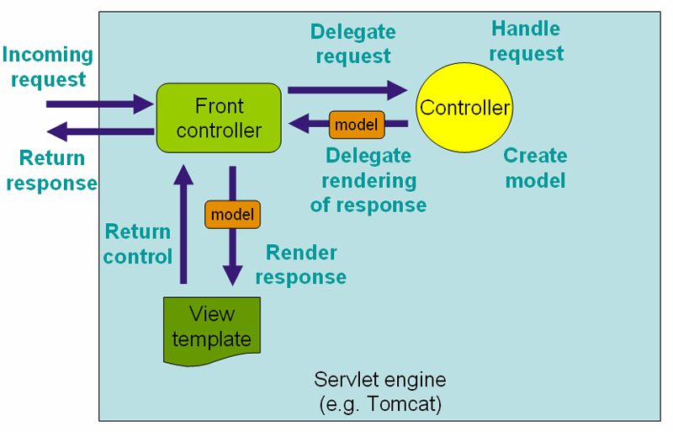
Spring MVC
The Spring web MVC framework provides model-view-controller architecture and ready components that can be used to develop flexible and loosely coupled web applications.
The MVC pattern results in separating the different aspects of the application (input logic, business logic, and UI logic), while providing a loose coupling between these elements.

Slide 25
Spring MVC MVC Bean Scopes
Scope | Description
Request | Scopes a single bean definition to the lifecycle of a single HTTP request; that is, each HTTP request has its own instance of a bean created off the back of a single bean definition. Only valid in the context of a web-aware Spring ApplicationContext.
Session | Scopes a single bean definition to the lifecycle of an HTTP Session. Only valid in the context of a web-aware Spring ApplicationContext.
Global Session | Scopes a single bean definition to the lifecycle of a global HTTP Session. Typically only valid when used in a portlet context. Only valid in the context of a web-aware SpringApplicationContext.
Application | Scopes a single bean definition to the lifecycle of a ServletContext. Only valid in the context of a web-aware Spring ApplicationContext.

Slide 26
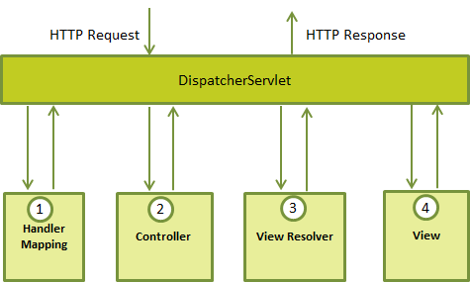
Spring MVC The DispatcherServlet
The Spring Web model-view-controller (MVC) framework is designed around a DispatcherServlet that handles all the HTTP requests and responses.

Slide 27
Spring MVC Web.xml
You need to map requests that you want the DispatcherServlet to handle, by using a URL mapping in the web.xml file.
<?xml version="1.0" encoding="UTF-8"?>
<web-app>
<display-name>Example</display-name>
<context:component-scan base-package="com.proj.web" />
<context-param>
<param-name>contextConfigLocation</param-name>
<param-value>
/WEB-INF/context/example-general-context.xml
</param-value>
</context-param>
<listener>
<listener-class> org.springframework.web.context. ContextLoaderListener
</listener-class>
</listener>
<servlet>
<servlet-name>spring</servlet-name>
<servlet-class>
org.springframework.web.servlet.DispatcherServlet
</servlet-class>
<init-param>
<param-name>contextConfigLocation</param-name>
<param-value>/WEB-INF/example-servlet.xml</param-value>
</init-param>
<load-on-startup>1</load-on-startup>
</servlet>
<servlet-mapping>
<servlet-name>spring</servlet-name>
<url-pattern>/</url-pattern>
</servlet-mapping>
</web-app>

Slide 28
Spring MVC Servlet.xml
Now, let us check the required configuration for example-servlet.xml file, placed in your web application's WebContent/WEB-INF directory:
<context:component-scan base-package="com.proj.web.controller" />
<bean id="viewResolver" class="org.springframework.web.servlet.view.UrlBasedViewResolver">
<property name="viewClass" value="org.springframework.web.servlet.view.JstlView" />
<property name="prefix" value="/WEB-INF/view/" />
<property name="suffix" value=".jsp" />
</bean>
<mvc:annotation-driven />
</beans>

Slide 29
Spring MVC Controller & View
HomeController.java:
Home.jsp
@Controller
public class HomeController {
@RequestMapping(value = { "/", "/home" }, method = RequestMethod.GET)
public String showHomePage(ModelMap model) {
model.addAttribute("message", "Hello Spring MVC Framework!");
return "home";
}
}
<html>
<head>
<title>Here is home page</title>
</head>
<body>
<h2>${message}</h2>
</body>
</html>

Slide 30
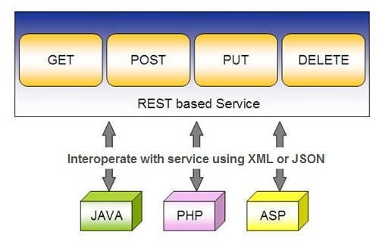
Spring RESTful Services
REST does not require the client to know anything about the structure of the API. Rather, the server needs to provide whatever information the client needs to interact with the service.

Slide 31
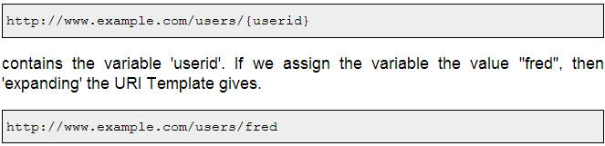
Spring RESTful Services
Spring's annotation-based MVC framework serves as the basis for creating RESTful Web Services.
RESTful services use URIs to name resources. To facilitate accessing the information contained in a URI, its structure follows conventions so that it can easily be described in a parameterized form.

Slide 32
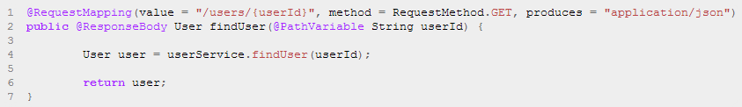
Spring RESTful Services
Spring uses the @RequestMapping method annotation to define the URI Template for the request. The @PathVariable annotation is used to extract the value of the template variables and assign their value to a method variable.
When a request comes in for /users/serhat, the value ‘serhat' is bound to the method parameter String userId.

Slide 33
Spring RESTful Services
A RESTful architecture may expose multiple representations of a resource. There are two strategies for a client to inform the server of the representation it is interested in receiving.
The first strategy is to use a distinct URI for each resource. This is typically done by using a different file extension in the URI.
For example the URI http://www.example.com/users/serhat.pdf requests a PDF representation of the user serhat while http://www.example.com/users/serhat.xml requests an XML representation.
The second strategy is for the client to use the same URI to locate the resource but set the Accept HTTP request header to list the media types that it understands.
For example, a HTTP request for http://www.example.com/users/serhat with an Accept header set to application/pdf requests a PDF representation of the user serhat while http://www.example.com/users/serhat with an Accept header set to text/xml requests an XML representation. This strategy is known as content negotiation.

Slide 34
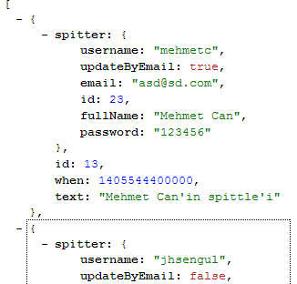

Spring RESTful Services
Do not forget to implement serializable in your entity

Slide 35
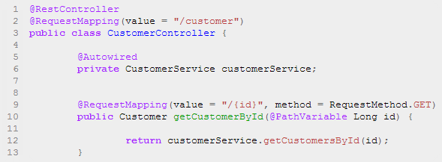
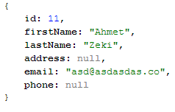
Spring RESTful Services
This code uses Spring 4’s new @RestController annotation, which marks the class as a controller where every method returns a domain object instead of a view. It’s shorthand for @Controller and @ResponseBody rolled together.
The Greeting object must be converted to JSON. Thanks to Spring’s HTTP message converter support, you don’t need to do this conversion manually.

Slide 36

Spring Security
Spring Security is a framework that focuses on providing both authentication and authorization to Java applications.
Features:
Comprehensive and extensible support for both Authentication and Authorization
Protection against attacks like session fixation, clickjacking, cross site request forgery, etc
Servlet API integration
Optional integration with Spring Web MVC
Much more...

Slide 37
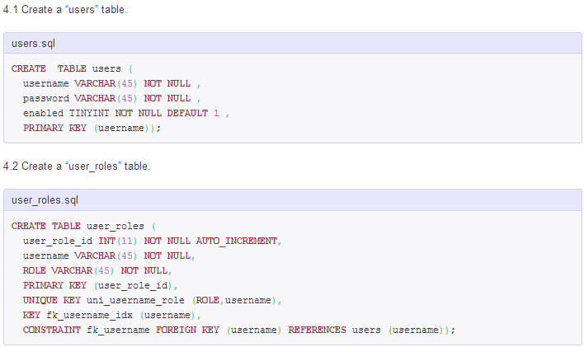
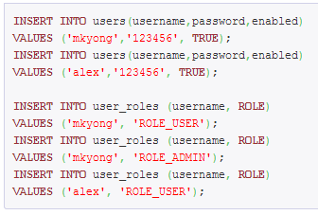
Spring Security Authentication & Authorization

Slide 38
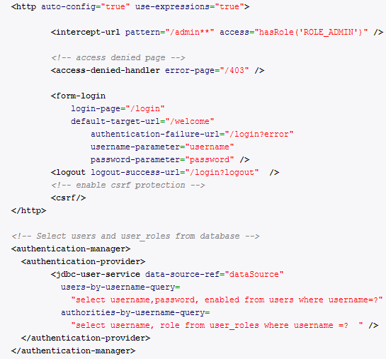
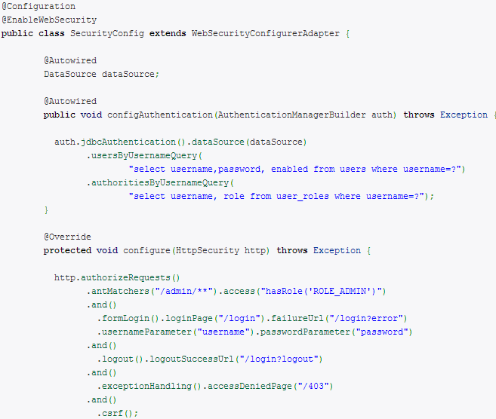
Spring Security Authentication & Authorization

Slide 39
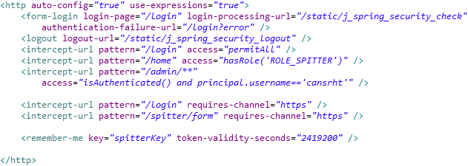
Spring Security Authentication & Authorization
Lastly, forcing application to use secure channel (https) is easy to implement in Spring Security.
Lastly, forcing application to use secure channel (https) is easy to implement in Spring Security.

Slide 40
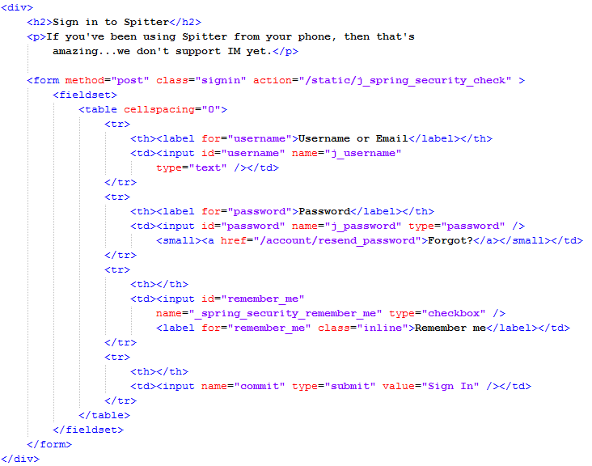
Spring Security Authentication & Authorization
Spring special naming for
Spring supported Authentication

Slide 41
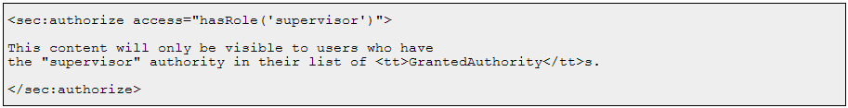
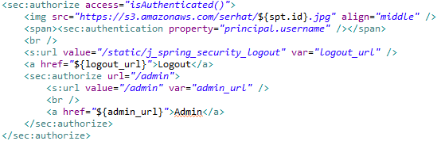
Spring Security Authentication & Authorization
The authorize & authentication tag

Slide 42
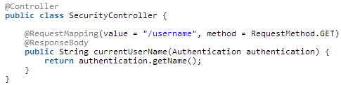
Spring Security Authentication & Authorization
You can access the Authentication object in your MVC controller (by calling SecurityContextHolder.getContext().getAuthentication()) and add the data directly to your model for rendering by the view.

Slide 43

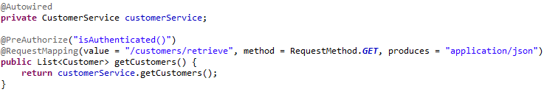
Spring Security Authentication & Authorization
Authorization with annotations in RESTful Web Service

Slide 44

Spring Test
Spring Test Framework supports;
Unit testing with mock objects
Easy unit testing for Controllers
IoC container to create dependencies for Integration Testing
Transaction management for Integration Testing
Third party frameworks like JUnit, TestNG, Mockito

Slide 45
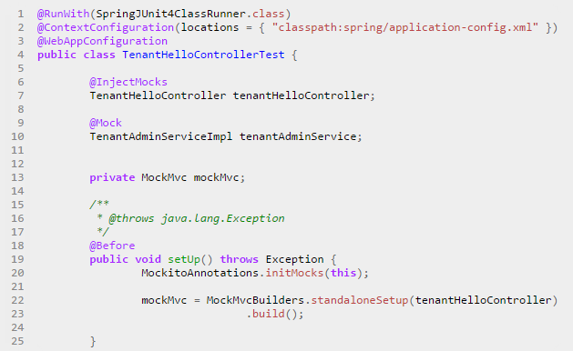
Spring Test Unit Testing

Slide 46
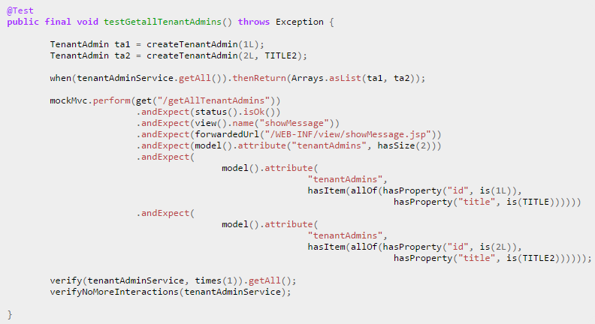
Spring Test Unit Testing

Slide 47
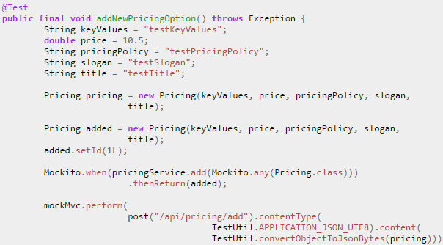
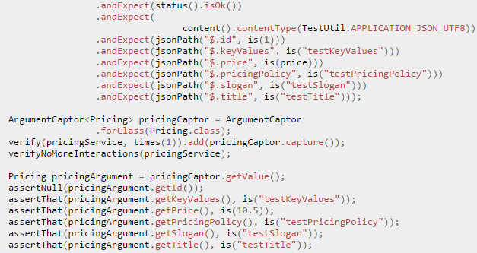
Spring Test Unit Testing

Slide 48
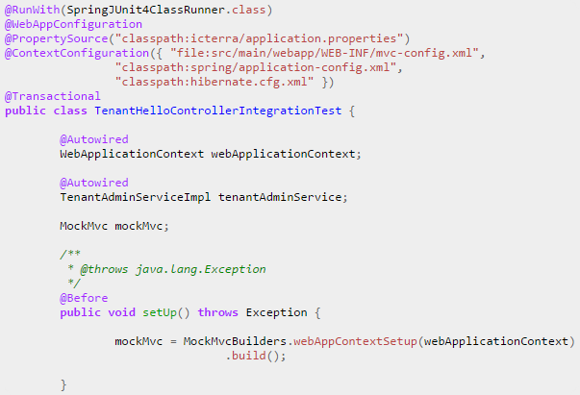
Spring Test Integration Testing

Slide 49
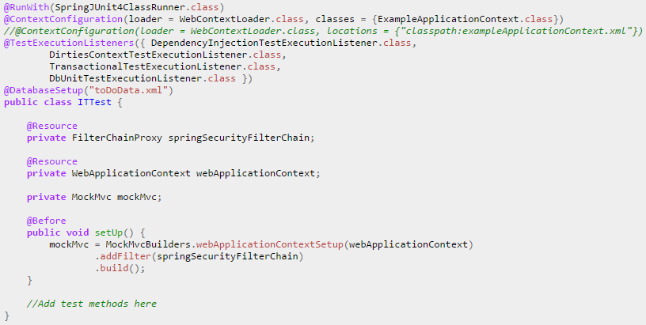
Spring Test Integration Testing

Slide 50
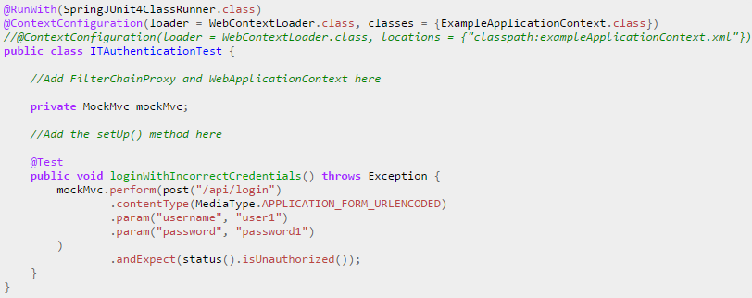
Spring Test Integration Testing

Slide 51
References
http://docs.spring.io/spring/docs/current/spring-framework-reference/html/
http://projects.spring.io/spring-security/
http://www.mkyong.com/tutorials/spring-mvc-tutorials/
http://www.mkyong.com/tutorials/spring-security-tutorials/
http://www.tutorialspoint.com/spring/
http://www.mkyong.com/tutorials/spring-tutorials/
http://www.slideshare.net/rstoya05/testing-web-apps-with-spring-framework-32
http://www.petrikainulainen.net/programming/spring-framework/integration-testing-of-spring-mvc-applications-security/

Slide 52
END

